Slide 1
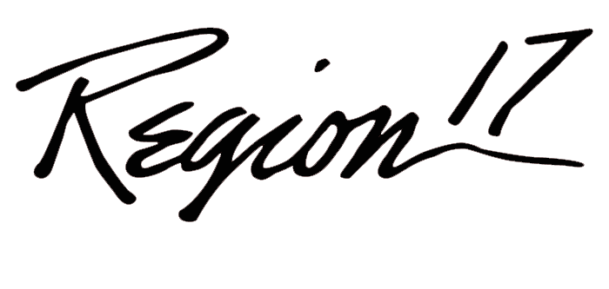
Fusing Accountability and TTESS
Ty Duncan, Coordinator of Accountability and Compliance
@instructionalle on Twitter
tduncan@esc17.net

Slide 2
TWEET! We are Listening!!
#TEPSA16
#esc17
Tag @instructionalle

Slide 4
What Concerns Do You have About TTESS?

Slide 5
Building Blocks of School Culture
^{Gruenert & Whitaker, 2015}
Notes:
12 Minutes

Slide 6
Great Cultures Develop People

Slide 7
Moving the Curve
Very rare practioners
98%
TINA

Slide 8
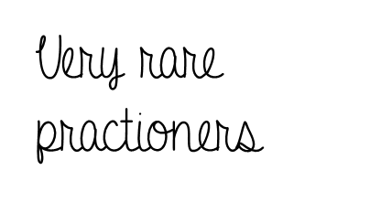
Moving the Curve
No TINA; just growth!
Everybody grows!

Slide 9
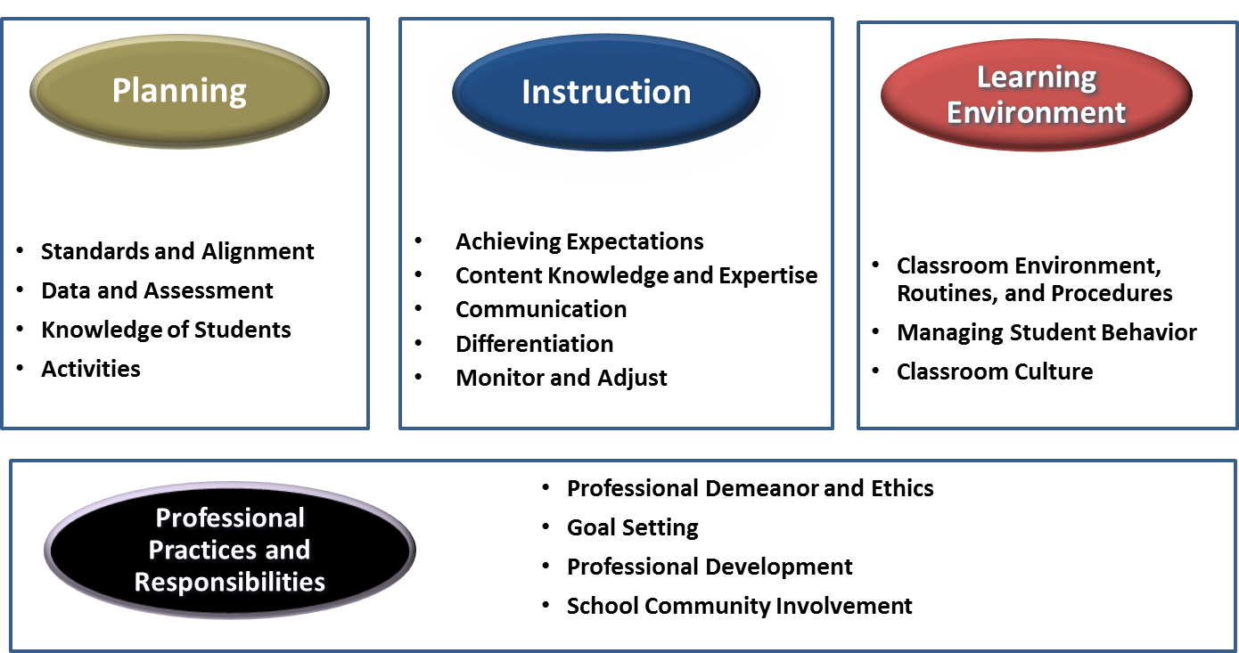
The Four Domains
Notes:
This is the four domains with correlated dimensions.

Slide 10
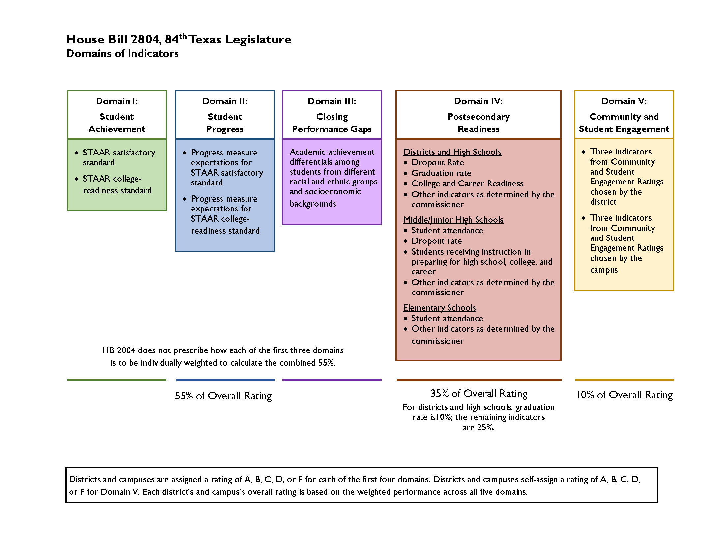
House Bill 2804, 84th Texas Legislature

Slide 11
Drivers of the Old and New System
Growth – Progress before performance! This applies to everyone in the system!
Level III Performance crucial to success in the system! Keep them at Level III for Index 2 and ensure those economically disadvantaged students are Level III for Index 3.
Post-secondary readiness
Closing Achievement Gaps

Slide 12
1) Strategy to Systems
Planning for student leadership; student data/standard awareness; teaching learning
Instruction determined by students and their needs; instillation of concern
Learning environment that hinges on student competency; creating culture (CONTAGIOUS)
Professional practices and responsibilities that contribute to vision and mission focus

Slide 13
2.1: Achieving Expectations
High, challenging expectations
Mastery of the objective
Student mistakes/self-corrections
Student initiative/self-monitoring

Slide 14
3.1: Classroom Environment, Routines
Procedures, routines, and transitions
Management of supplies/equipment
Safety and organization

Slide 15
3.2: Managing Student Behavior
Behavior systems
Behavior standards

Slide 16
3.3: Classroom Culture
Relevant, meaningful learning
Working respectfully (individual and group)
Collaboration and rapport

Slide 17
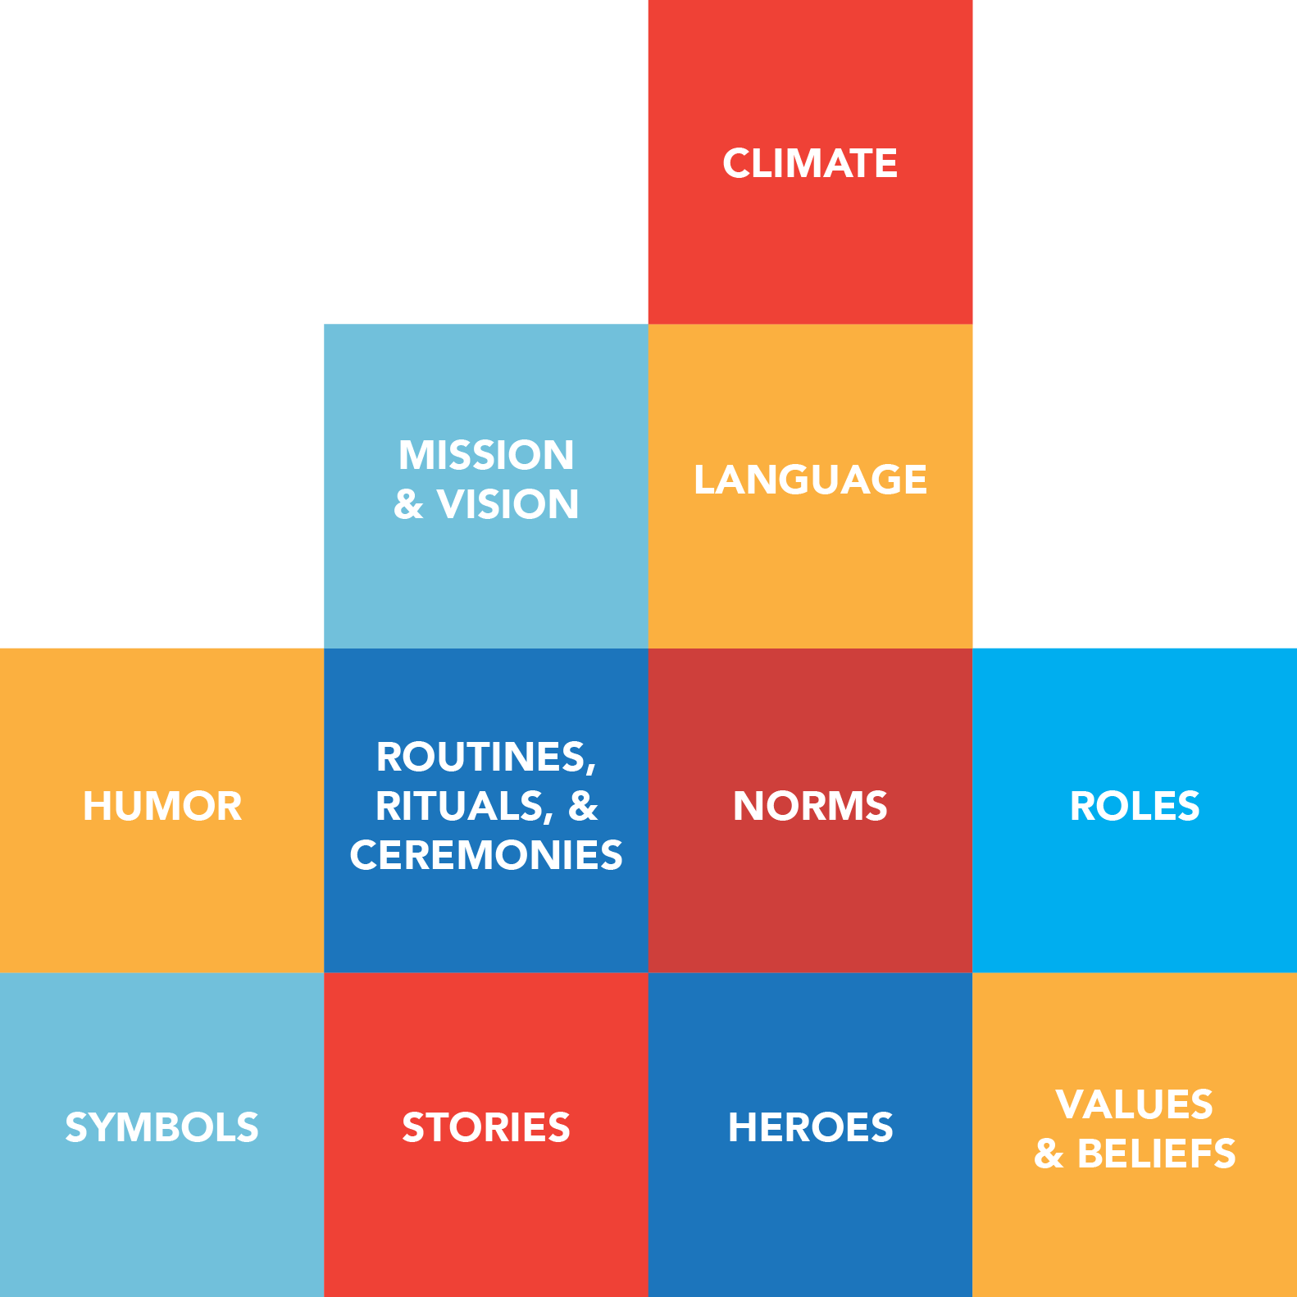
2) More Than Just A Passing!
Growth as a cultural value!
What data do you publish first?
What language do you use to ensure a growth mindset?
What do you celebrate?
What language in TTESS drives growth?

Slide 18
2.1: Achieving Expectations
High, challenging expectations
Mastery of the objective
Student mistakes/self-corrections
Student initiative/self-monitoring

Slide 19
2.2: Content Knowledge & Expertise
Content knowledge in multiple contexts
Objectives tied to other disciplines (cross-disciplinary)
Anticipating misunderstandings and teaching techniques
Thinking/HOTS
Sequencing and linking instruction

Slide 20
T-TESS and accountability through an RTI system

Slide 21
Instruction Matters!
Appropriate instruction literally changes the way in which the brain communicates among neurons.
A poor reader’s brain pattern, after appropriate remediation, changes to look like a good reader’s brain!
Notes:
Impress upon administrators that it is very possible to alter how a poor reader uses his/her brain, thus improving reading skills!

Slide 22
T-TESS and Accountability Through an RTI System
Planning Domain
Goals Measurable Goals
Relevant Activities Relevant to Prior Understanding
Progress Monitor Plan with Data
Analysis of Data Data Drives student success
Homogeneous Grouping Same + Accountability

Slide 23
T-TESS and Accountability Through an RTI System
Instruction Domain
Accurate Knowledge Content Depth of Content Knowledge
Anticipates Misunderstandings Same + Has a Plan
Uses Probing Questions Uses Questions to Extend Learning
Differentiates Differentiates to ensure Mastery
Receives input from Students Uses Input to Adjust Pacing of Lesson
Monitors Student Behaviors Continually Checks for Understanding

Slide 24
Strong Leadership
What administrators can do:
Involve everyone in the creation and nurturance of a strong vision.
Let data drive your instruction—this is about kids, not adults!
Organize and support strong literacy teams at grade levels and across grades.
Emphasize uninterrupted, quality classroom instruction with flexible groupings.
Provide opportunities for continual professional development.
Become educated about best practices in literacy.
Notes:
Review each of these items concerning strong leadership:
Involving everyone includes not only teachers but paraprofessionals; specialists; tutors; support staff; secretarial, janitorial, and cafeteria staff; parents; community members; and higher education faculty.
The use of data, which takes expertise to analyze, is crucial to the success of grouping students for instruction in both core and intervention programs.
Strong literacy teams create local capacity, where staff members drive the literacy initiative. No one person can do this alone.
Ensure that there are no intercom announcements during literacy time, no interruptions by phone, no field trips or activities instead of literacy instruction, etc. This message should be given to secretarial staff and all those responsible for making the building run smoothly.
Provide financial support and scheduling to create Professional Learning Communities (PLC) in order to provide continual professional development.
Become educated in best practices. While time consuming, this is arguably the best way for administrators to truly understand and support literacy initiatives. Much of these best practices are outlined within LETRS Module 1.

Slide 25
Resources to Develop an RTI system to support Growth in Teachers and Students
http://www.rti4success.org/sites/default/files/NCRTI_District_Rubric%20and%20Worksheet_061112.pdf
http://buildingrti.utexas.org/documents/example-assessment-plan-pk-12
http://buildingrti.utexas.org/
The Texas State Literacy Plan

Slide 26
3) Grit!
"If you're a leader & you want your organization (team) to be grittier, create a gritty culture.” – Angela Duckworth, Grit
There are some parts of TTESS and Index Accountability that are hard and require a grind!
Teachers need to see leaders grind!

Slide 27
2.4: Differentiation
Individualized lessons
Monitoring participation & performance
Differentiated content and methods (process)
Recognizing confusion and disengagement

Slide 28
4.2: Goal Setting
Goals—short- and long-term
Self-assessment

Slide 29
What Can You Do to Maximize Results!

